Slide 1

Investment – Property
Budapest – City center
V. District
2. Floor
77 m²

Slide 2
Cost Calculation
Project: V. District 135 m²
Property description:
Cost of flat (fully furnished) | 565.000€
Location:
The apartment is located in the the most famous district of Budapest, V. district downtown. The property is in the oldest and most famous street of Budapest, in the Váci utca, so called The Fashion Street. The property is located on the 2nd floor of a renovated, quiet building with a full street front view. The property was completely renovated with the greatest care by our own team.
The property:
The property is fully renovated and furnished in high quality which includes the following:
  New water pipe system incl. water heating (Boiler)
  New heating system
  New electricity network (cables, switches, entire electricity box)
  Renovated walls and ceilings as well as sound proved walls and ceilings
  New floor
  Bathroom and toilet full re-design
  New doors and windows
  High quality furnishing
 | 1 year | 5 year
Profit return from rent | 18.000 € | 90.000 €
Value increase of property (10%) | 56.500 € | 282.500 €
Total value of property after 5 years |  | 655.000 €
Total Profit |  | 372.500 €
Taxes:
Private Pruchase:
Income tax: 0% after holding property of 5 Years
(Sales between 0-5 Years will be taxed 15%-0%)

Slide 3
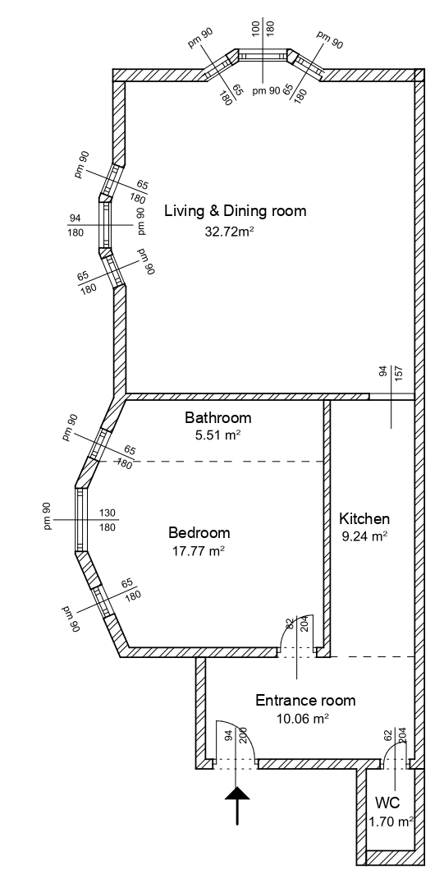
Floorplan 77m²
View Váci utca
View Haris Köz

Slide 4
